Slide 1
Artificial intelligence in Concrete

Slide 2
Speaker
Master of Applied Science in Civil Engineering
Member of ACI 207-Mass and Thermally Controlled Concrete
Member of ACI 306- Cold Weather Concrete
Sarah De Carufel
Manager of Engineering Solution

Slide 4
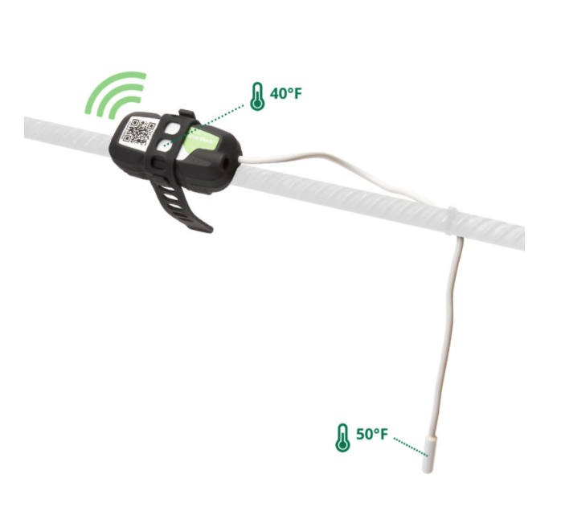
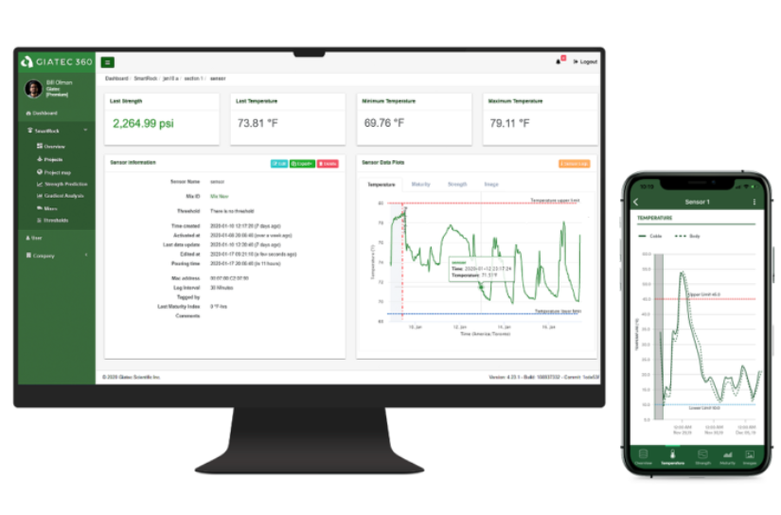
SmartRock

Slide 5
What is Artificial Intelligent (AI)?
AI in concrete- Introduction to Roxi
AI for pouring time
AI for mix verification
SmartMix – AI for mix optimization and CO2 reduction

Slide 6
Artificial Intelligence

Slide 7
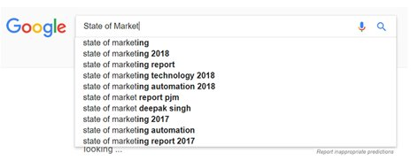
What is Artificial Intelligence (AI)
The science of providing computer systems the ability to automatically learn and improve from experience without being explicitly programmed

Slide 8
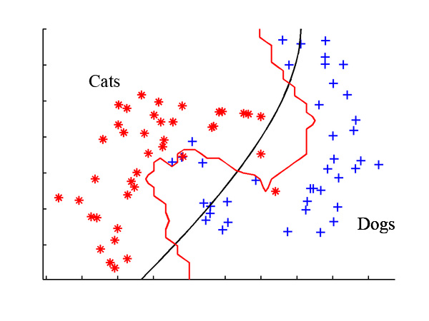
Artificial Intelligence (Machine Learning)
We have the input data and we labeled the outputs, let’s automate a decision process
Notes:
-input data that we already have labeled
-use the computer to analyze each picture, develop a relationship between the input and output and give us a definitive output of whether it’s a cat or dog

Slide 9
Artificial Intelligence In Concrete

Slide 10
Roxi: Who is she?
The first AI program created for concrete testing.
Since April 2019 Roxi has been trained for :
Concrete pouring time
Concrete performance prediction
Mix optimization (CO₂ & cost)
She is still learning !

Slide 11
Roxi: AI for Pouring time
Goal: Suggests pouring time based on temperature history in your concrete
How: Trained on over 10,000 of temperature curves in concrete and identified the pouring time

Slide 12
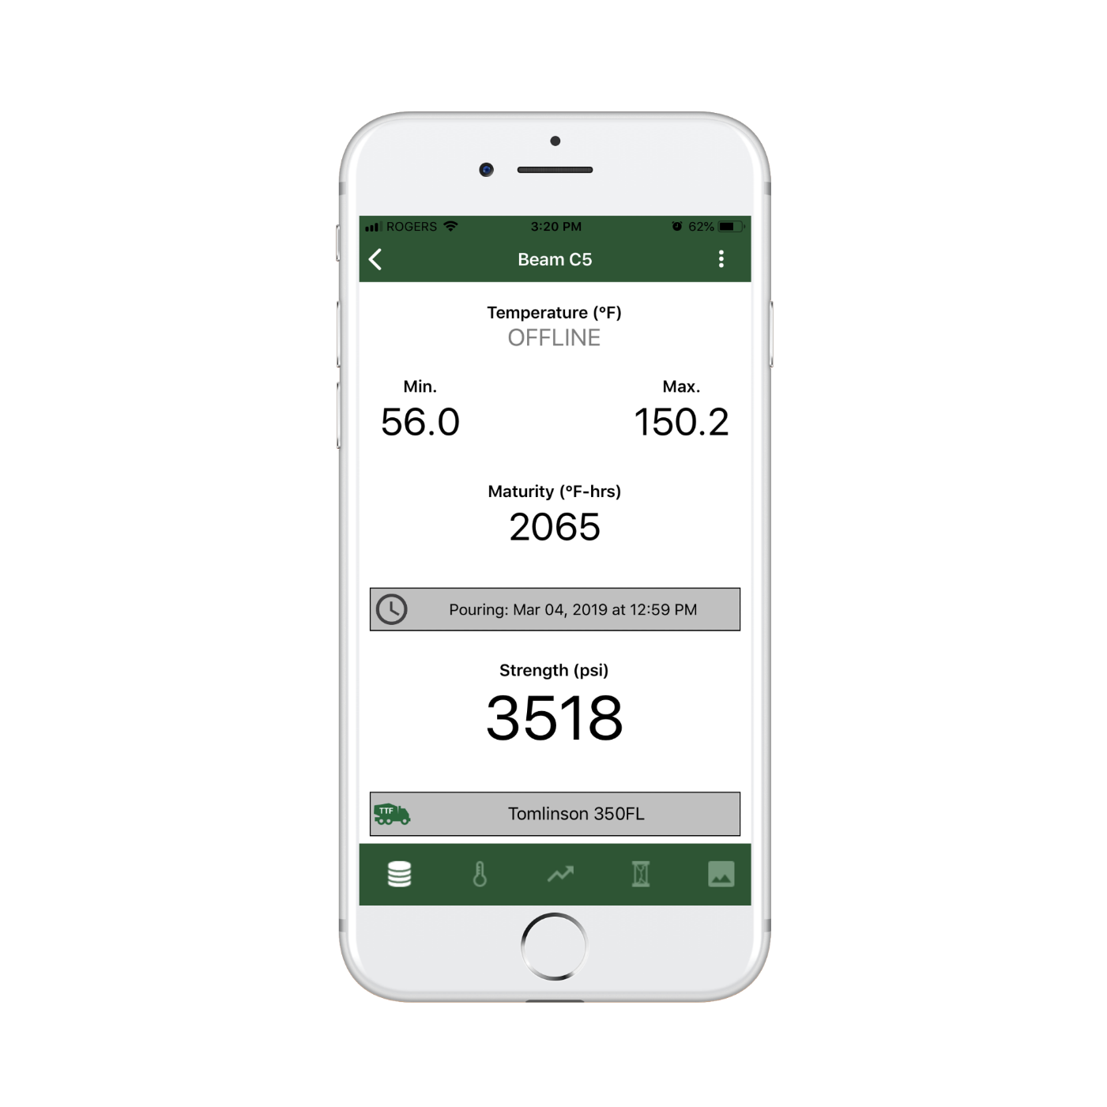
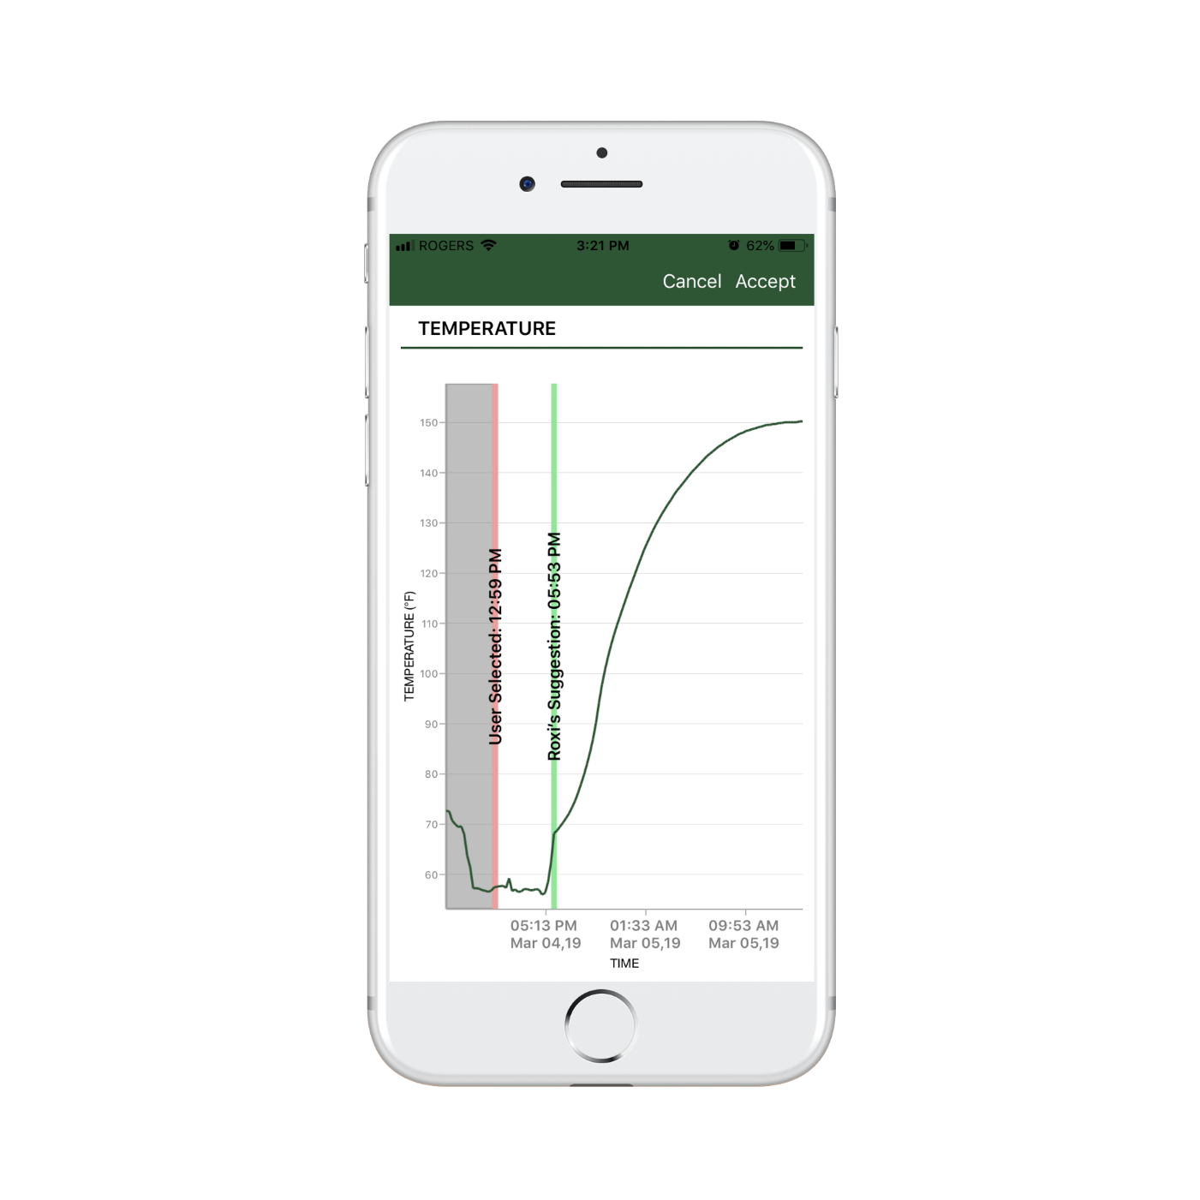
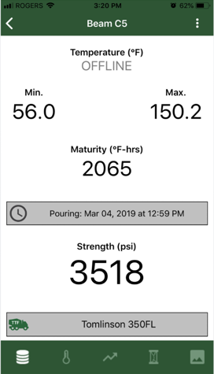
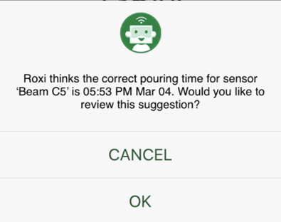
Roxi: AI for Pouring time

Slide 13
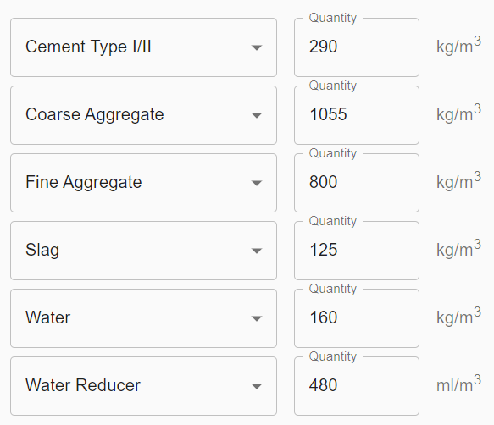
Roxi: Concrete performance prediction
Goal: Determine concrete strength simply based on the mix design input
How: Trained on thousand of mix designs from all over the world. Collected mix ingredients and strength performance over multiple years.
Inputs : mix design Output: Concrete Strength vs. Age

Slide 14
Implementing concrete performance prediction
SmartRock leverages the concept of concrete maturity to determine concrete in-place strength.
The maturity method required a maturity calibration
Garbage In Garbage Out
Input from user: System Output:
Maturity calibration data points
Mix design

Slide 15
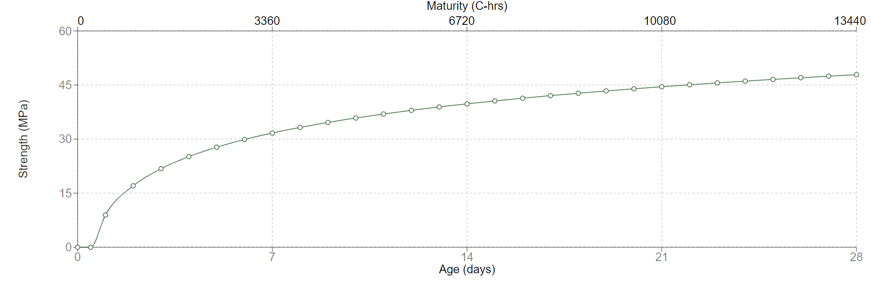
Performance prediction implementation

Slide 16
Roxi: Mix Optimization
Goal: Determine if your concrete is over deign and proposed solution to reduce the cement consumption and the cost of the mix design
How: Used the same data based for training, but also incorporated fresh propertie.
User Input: System output:
Mix design
Fresh properties (air and slump)
Specified strength ( target)

Slide 17
Mix optimization implementation
1% reduction
2% reduction

Slide 18
SmartMix

Slide 19
Introduction to SmartMix
AI-Based platform
February 2021-Beta- Free

Slide 20
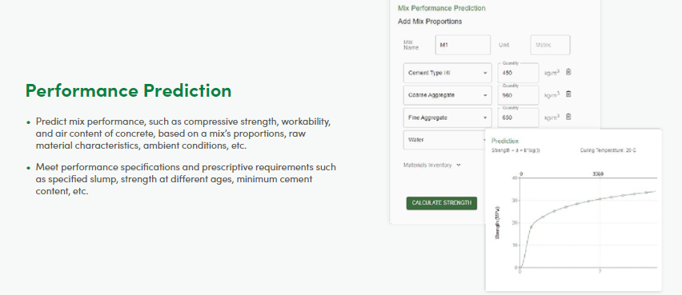

Slide 21
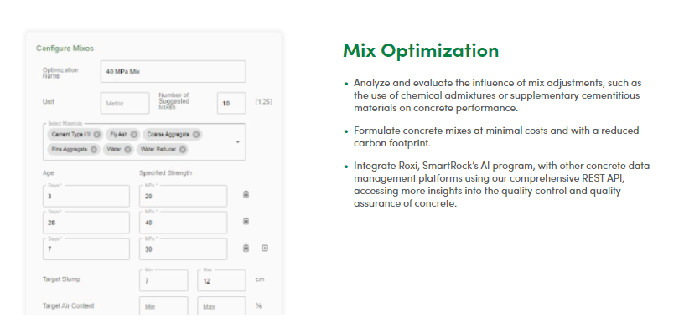

Slide 22
SmartMix- Optimization
User can specify if they want to optimize for cost and CO2 or both
Program provides a list of mixes that satisfies the requirements with the optimized values.

Slide 23
support@giatec.ca sales@giatec.ca

