Slide 1
Introduction
Presented by: Jaden Texeira, EIT
Technical Account Manager

Slide 2
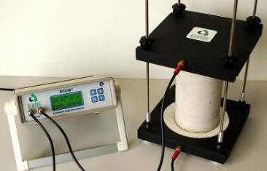
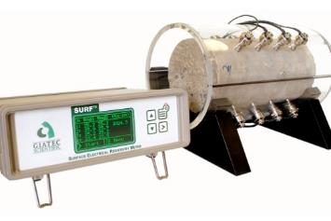
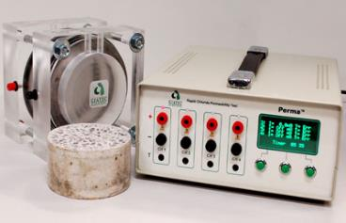
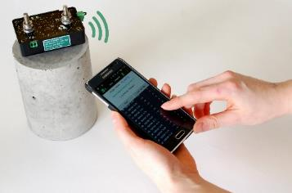
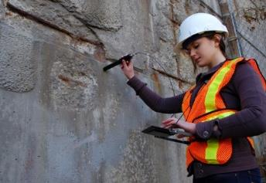
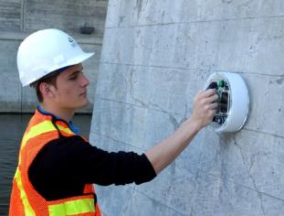
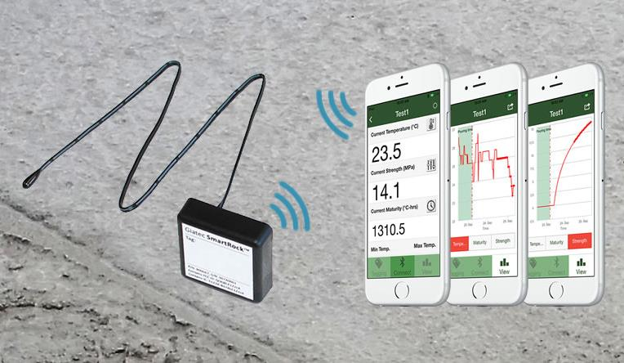
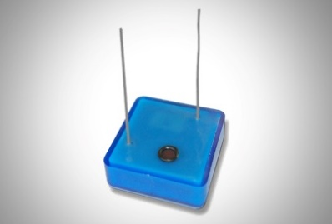
Lab Devices
Giatec RCON2™ Giatec Surf™ Giatec Perma2™ Giatec SmartBox™
Corrosion Devices
Giatec XCell™ Giatec iCOR™
Smart Concrete Sensors
Giatec SmartRock™ Giatec BlueRock™
Notes:
Giatec Scientific Inc.
新型混凝土技术：
以耐久性为基础的质控
RCON2, Surf, Perma2
基础设施状况的准确评估
Xcell, iCOR （新）, SmartBox（新）

Slide 3
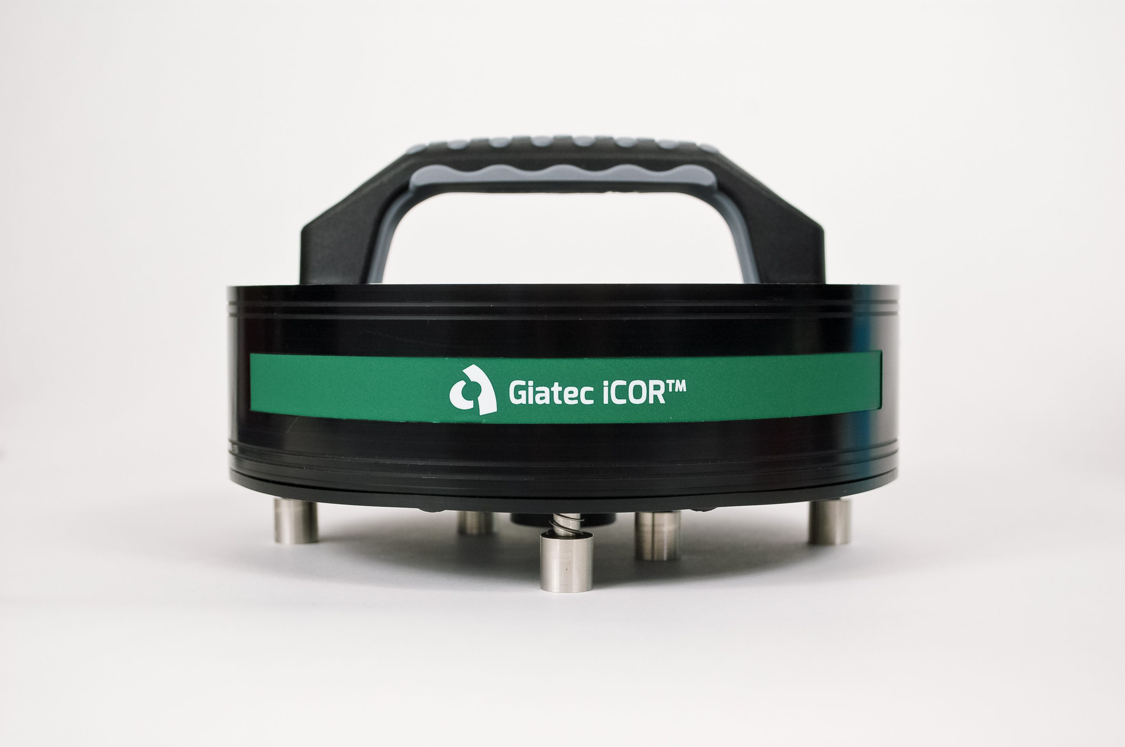
Corrosion Assessment of Infrastructure with
iCOR
TM

Slide 4
2019 MP Corrosion Innovation of the Year Award
iCOR
TM
⸳ More than 50 nominations for the 2019 program (an all-time record)
⸳ Each nomination is required to show the potential for a significant positive impact in corrosion control
⸳ Innovations can be related to coatings and linings, materials, design, equipment, testing, monitoring, integrity assessment, cathodic protection, chemical treatment, or anything else directly related to corrosion prevention and mitigation
⸳ Winners selected by a panel of corrosion-control experts

Slide 5
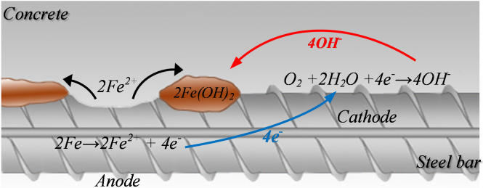
Corrosion of Reinforcement
Initially, there is a small passive layer that is formed at the surface of the steel rebar which acts as the capacitance.​
Electrochemical reaction: electrons migrate from the anodic zone to the cathodic zone, releasing ferrous ions at the anode and hydroxide ions at the cathode. ​
Leads to a potential difference between the anodic and cathodic areas at the surface of the steel reinforcement. ​

Slide 6
iCORTM Measurement Output
Corrosion rate
Electrical resistivity
Half-Cell potential (optional: requires connection to reinforcement)
B = corrosion constant
A_{p} = area of polarization
R_{p} = polarization resistance
a = distance between electrodes
R_{c2} = concrete resistance
Notes:
Other

Slide 7
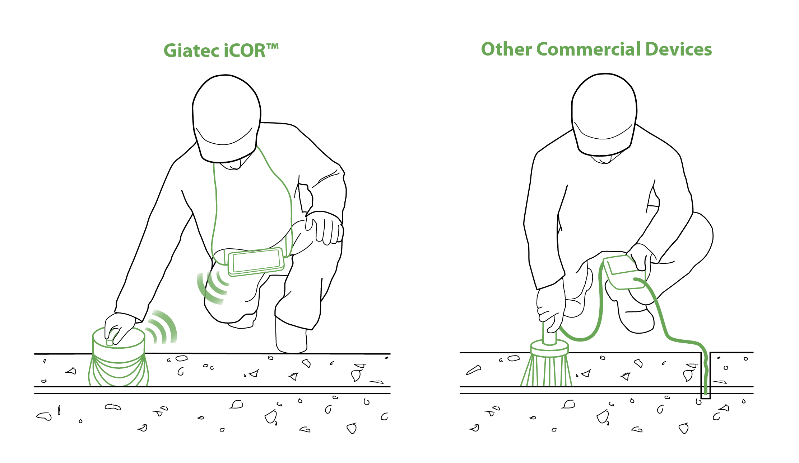
Corrosion Rate Measurement Techniques
Linear polarization technique​
Galvanostatic pulse technique​
AC impedance analysis (lab technique)​
Connectionless Electrical Pulse Response Analysis (CEPRA)
Notes:
LPR – sweep the voltage on 10mV on either side of the potential value (Direct current)
Galvo – provides a pulse (current) and then measure the change in voltage feedback (Direct Current)
Ac Impdeance – apply AC current at a large range of frequency and get a rp value

Slide 8
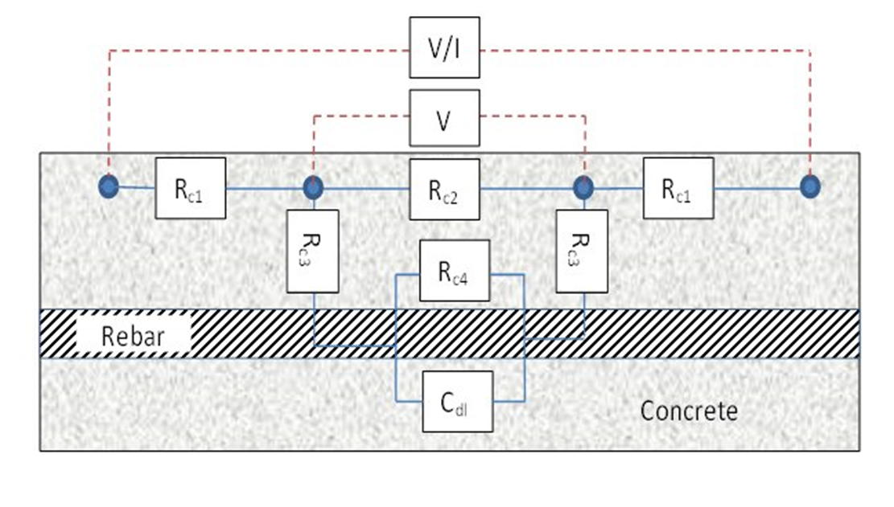
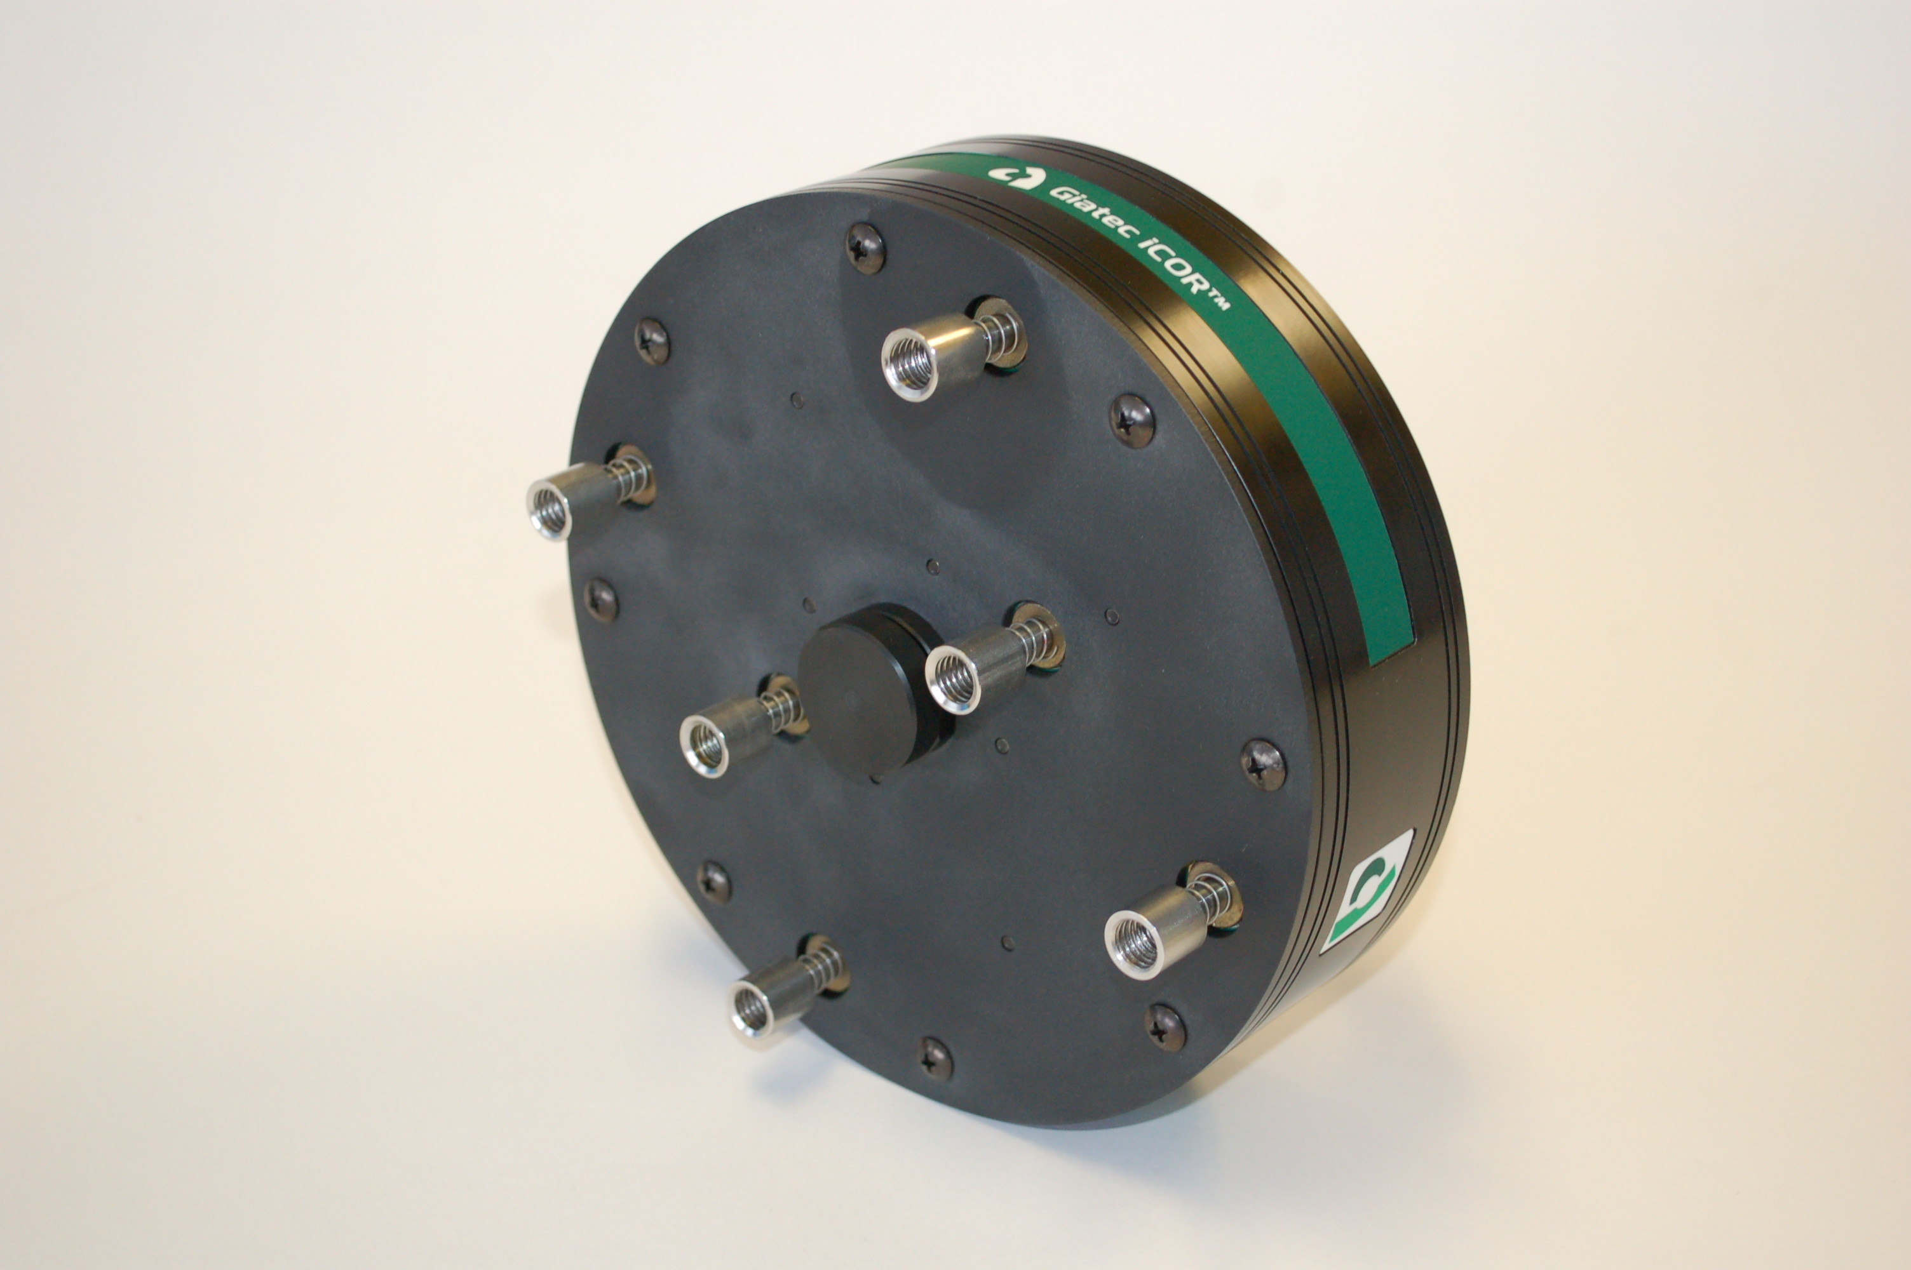
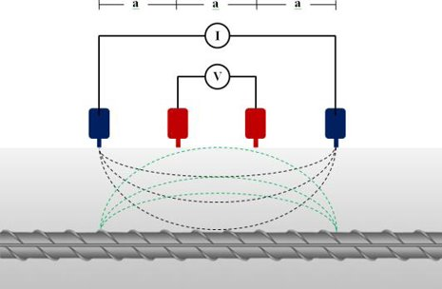
CEPRA Measurement Concept
Notes:
Other

Slide 9
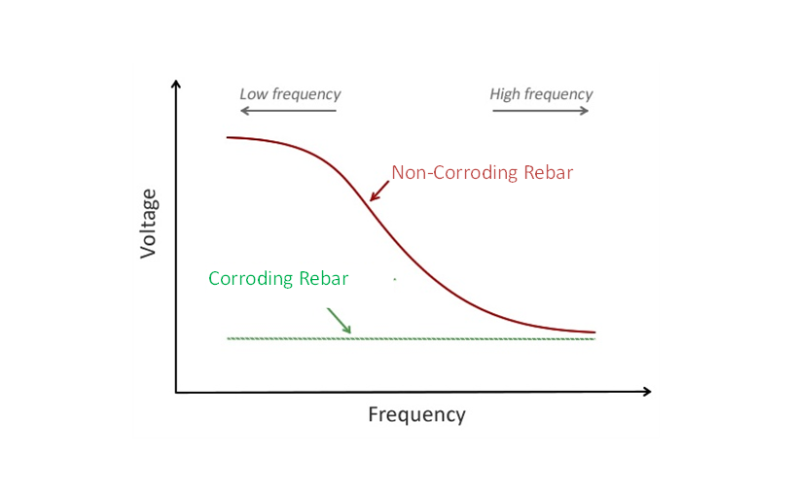
CEPRA Measurement Concept
Notes:
Other

Slide 10
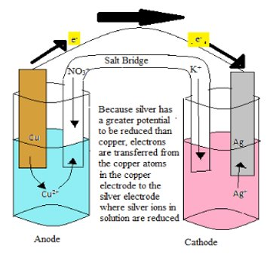
Half-Cell Potential Concept
Measures how much voltage exists between the two half cells.
​
The potential difference is caused by the ability of electrons to flow from one half cell to the other.
Notes:
Other

Slide 11
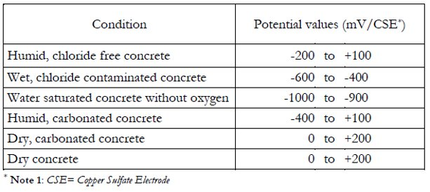
Standards
Relation between the potential values and corrosion probability ( ASTM C876)
Typical ranges of half-cell potentials of rebar in concrete (RILEM TC-154,2003)
Notes:
Other

Slide 12
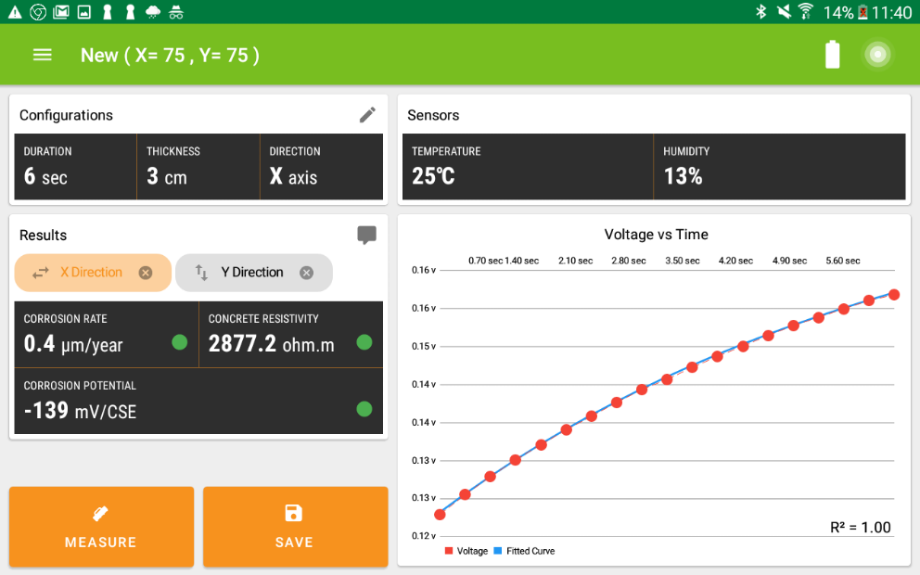
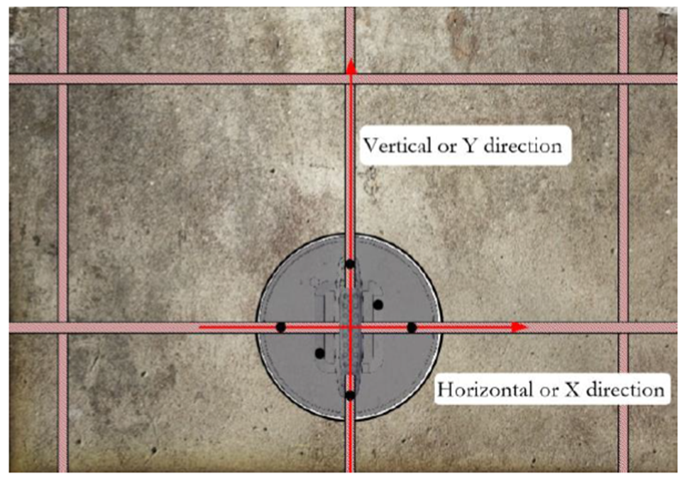
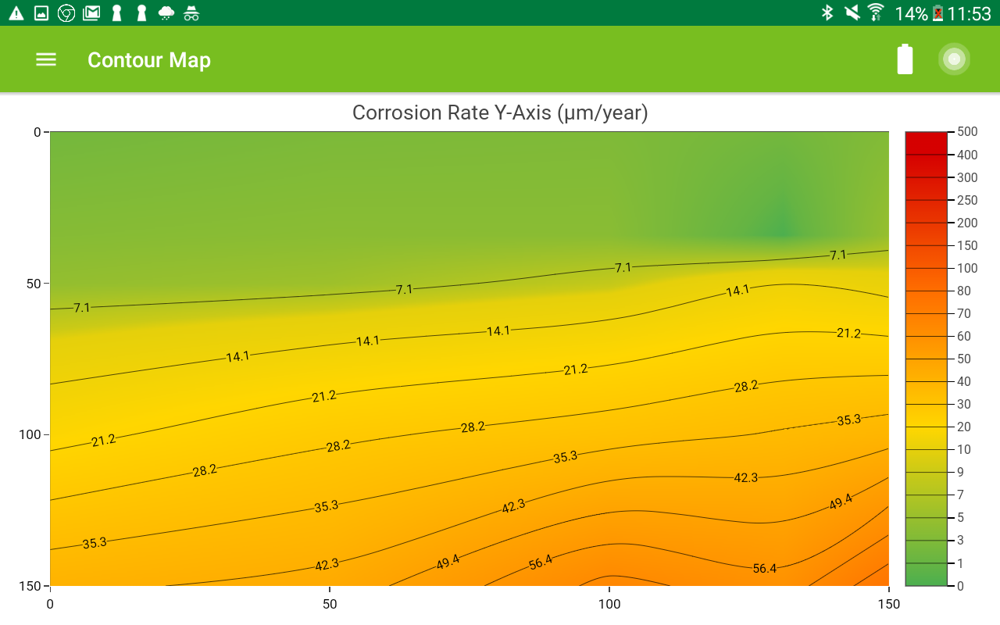
Theory to Application
Corrosion Rate
(CEPRA)
+
Half-Cell Potential

Slide 13
iCORTM Android Application
Perform verification
Prepare concrete surface (wet)
Create grid (rebar location)
Determine cover thickness and bar dimension.
Open application
Define project
Wet the sponge
Make measurements
Create a contour map
Save and share data
Maintenance: Electrode storage solution
Notes:
Other

Slide 14
iCORTM Android Application
Notes:
Other

Slide 15
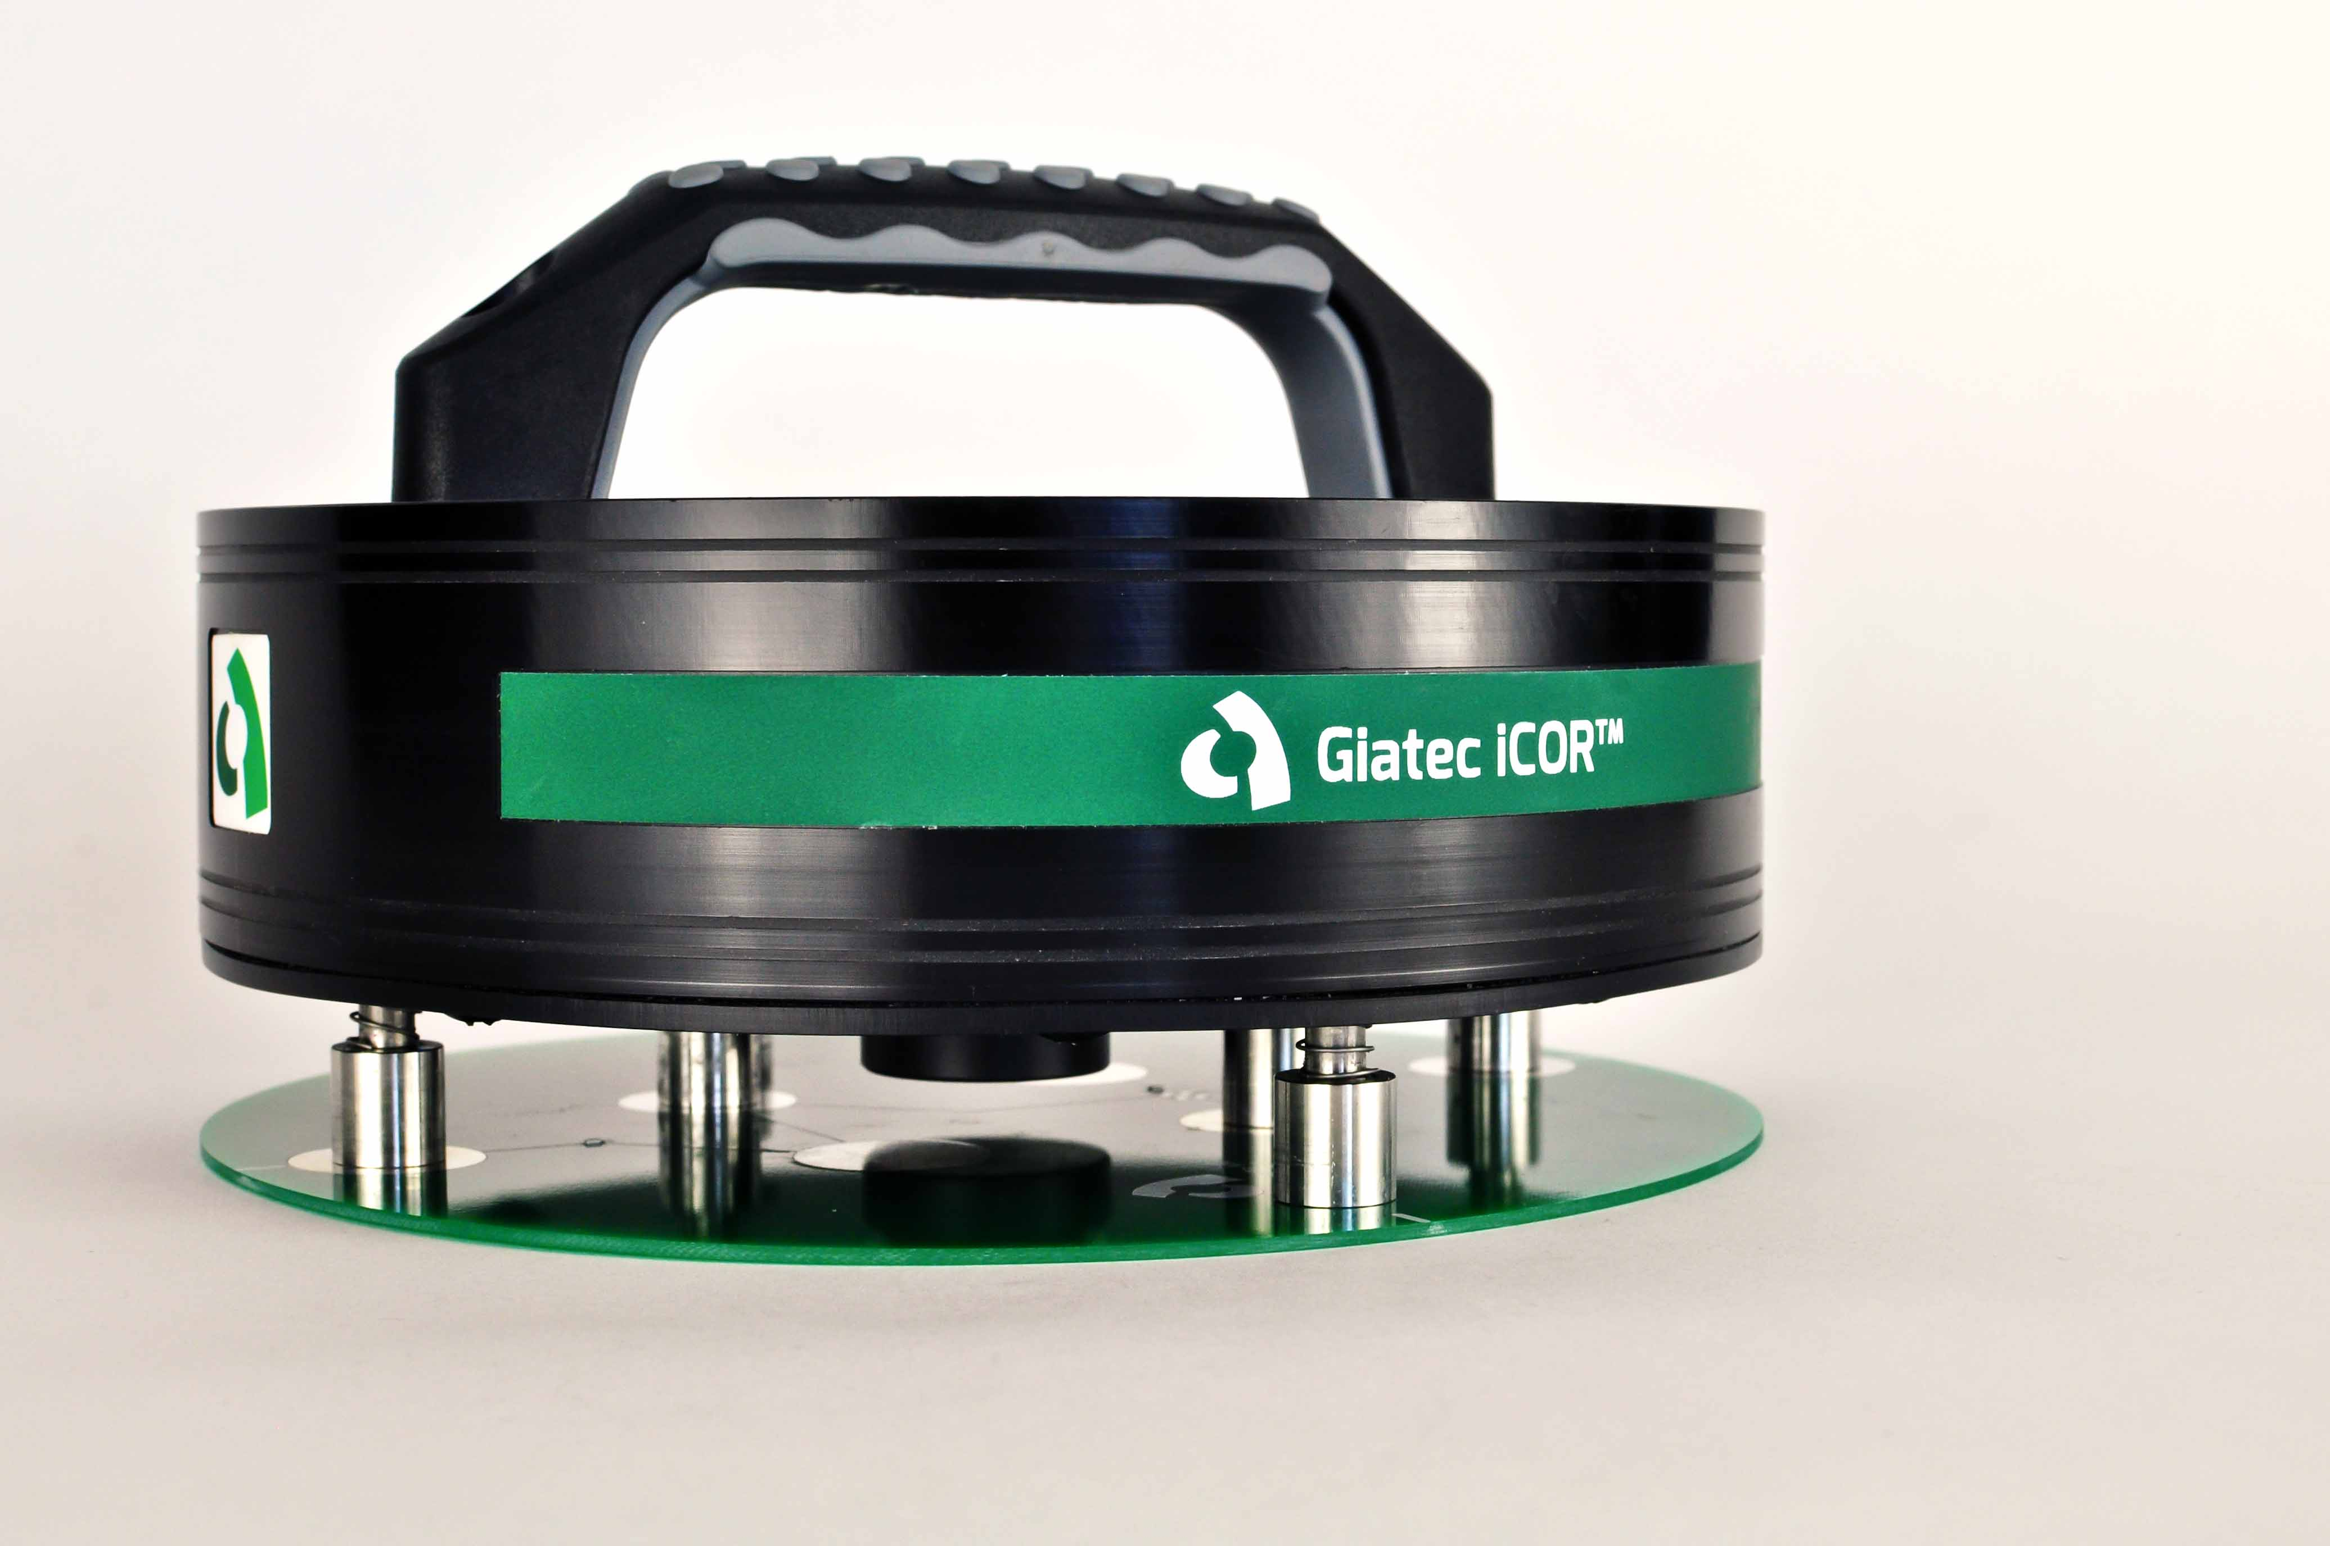
Verification
Notes:
Other

Slide 16
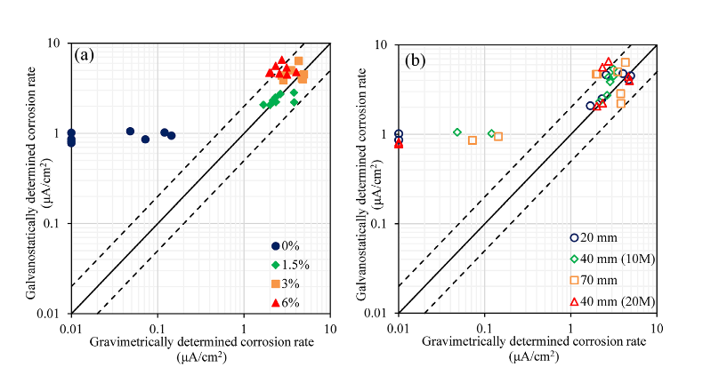
Accuracy of Results

Slide 17
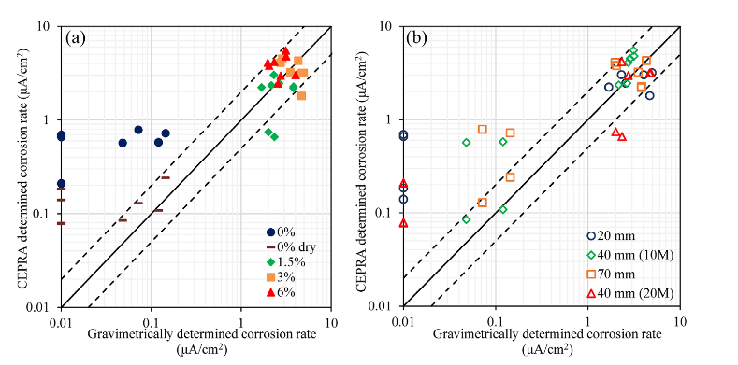
Accuracy of Results

Slide 18
Notes:
Other

